Slide 1
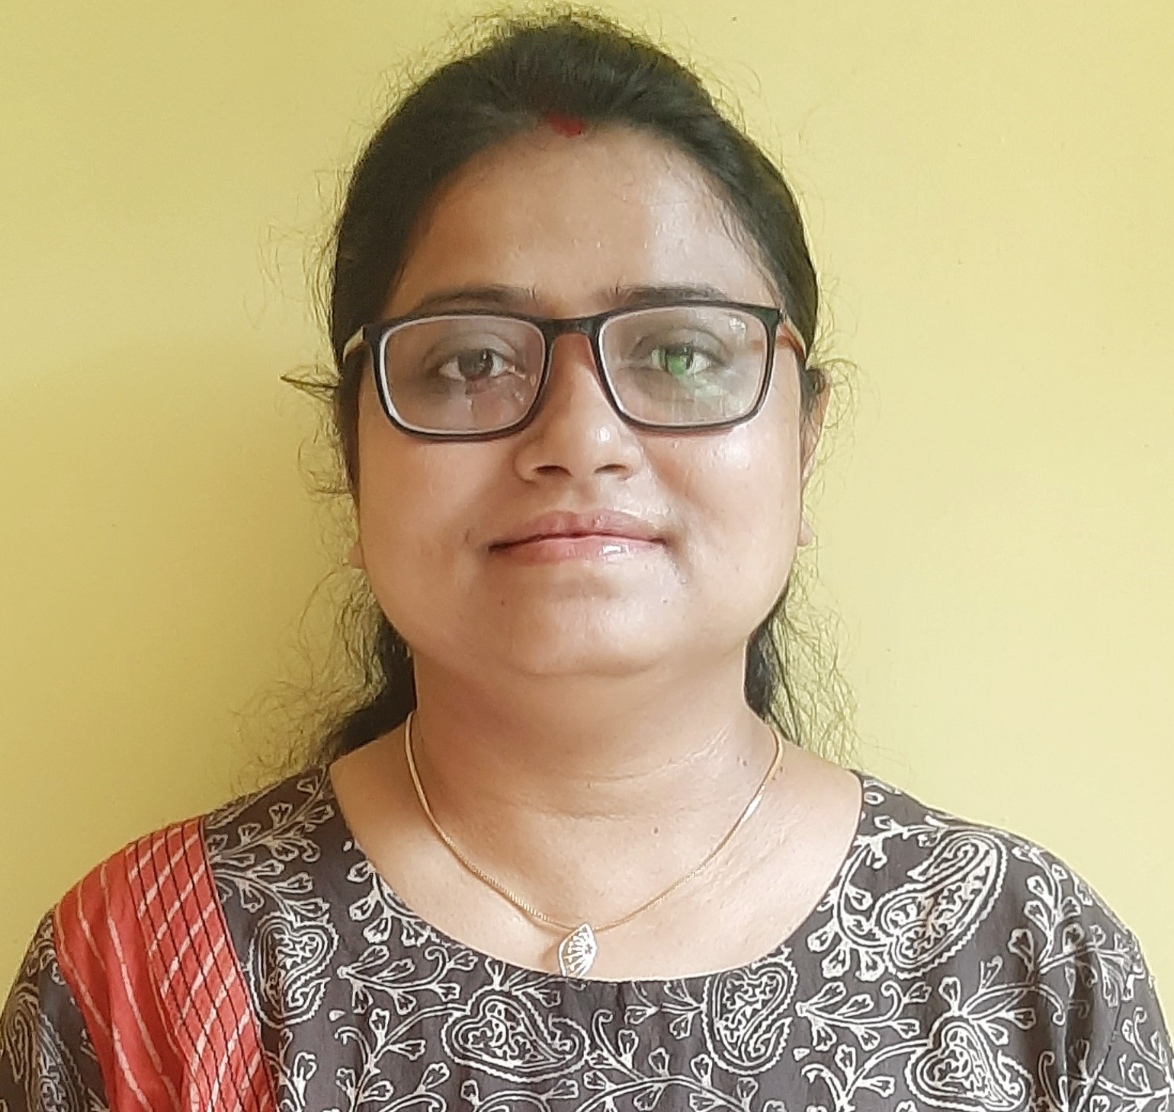


Swati Saha
Solution Architect – Open Banking | Digital Banking | Embedded Finance Generative AI
E-Mail: swati.saha@tcs.com
Phone: +91-9836337162
Kolkata, India
Solution Architecting
Technology Architecture Design
Technology Consulting
Digital Transformation
Domain-Open Banking
Consumer Finance
Microservice Based Architecture and Design
Cloud Computing (AWS/AZURE)
Presales and Client Negotiation
Stakeholder Management
Agile & DevOps
Programming Skills( JAVA/J2EE)
Experienced software professional with more than 18 years in the industry, specializing in technology and solution development within the Banking and Financial domain. Expertise includes Open Banking, Digital Banking.
Solution architect for the Open banking strategic initiatives responsible for creating next generation open banking offerings, strategic consulting and co-creation of open banking propositions with customers.
Played Consulting role in Open Banking domain for various geographies including UK, Europe, Australia.
Application architect for Checkout Finance-BNPL solution for major e-commerce player of India.
Designed Open Banking solution (cloud native Consumer Data Rights platform) for regulatory compliance requirement for a major Australian Credit Union.
Involved in preparing Enterprise Architecture roadmap for one of the largest UK based building societies for their digital transformation journey.
Built strategic and implementation roadmap on Open Banking for a Multi-National Bank operating in Europe.
“Entrepreneur” with experience in setting up BFSI garage as a start-up within TCS.
Expertise in requirement analysis, system designing as per Microservice architecture principles.
Strong exposure in DevOps and Agile culture.
Extensive work experience in Enterprise Content Management.
Mentored team members with clearly outlined vision and goals.
IT Leader with expertise in managing complex engagements and driving continuous improvements through innovative approaches.
Core Competencies
Profile Summary
The Open Group TOGAF 9 Certified
AWS Solution Architect
Microsoft Azure Fundamentals
Professional Scrum Master
EMC Certified -Content
Management Fundamentals
Sun Certified Java Professional
Certification

